Slide 1
The New Transportation Guide and Resources

Slide 2
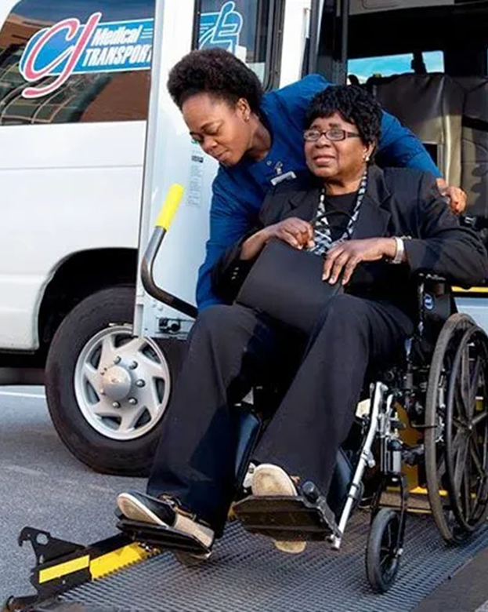
Transportation
Transportation is important to all of us--it links individuals to social connections, religious activities, medical appointments, groceries, pharmacies, and much more.
Consider how you would maintain your connection to the community if you could not drive?
“According to the American Journal of Public Health, individuals on average can expect to live between 6 to 10 years retired from driving.”
Notes:
A comparison of the men’s and women’s driving life expectancies with total life expectancies found that subsequent to driving cessation, men will have about 6 years of dependency on alternative sources of transportation, compared with about 10 years of dependency for women. - https://www.ncbi.nlm.nih.gov/pmc/articles/PMC1447231/

Slide 3
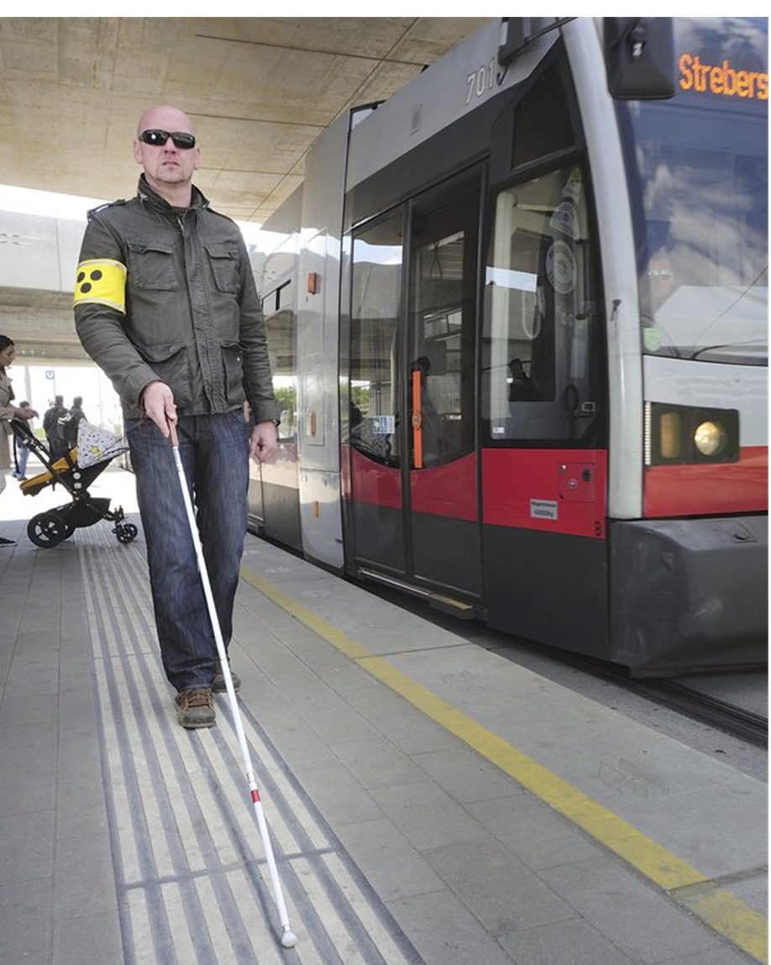
Transportation
Transportation remains among the top unmet needs identified among older and disabled adults.
Goals for today’s presentation:
Raise awareness of this unmet need.
Increase familiarity of local transportation resources for ourselves and our loved ones.
Encourage individuals to develop transportation alternatives as part of their long-term aging plan.
Notes:
“In a 2018 national survey of older adults, people with disabilities and caregivers conducted by the NADTC, the survey reported that most of the respondents turned to family, friends or neighbors for information about transportation services available in the community.”

Slide 4

INTRODUCING…
This Guide is designed to assist older adults and people with disabilities seeking transportation services. agencies with transportation needs.
Notes:
The Transportation Guide is a resource designed to aid both individuals and community service agencies, and is available in both hard copy and electronic version. The Guide provides definitions of the different types of transportation services, and lists contact information for the corresponding services agencies across the nine-county Centralina region as well as Lancaster and York Counties in South Carolina. In addition to helpful tips and considerations when using transportation services, the Guide also explains services such as Lyft and Uber and how to use them.

Slide 5
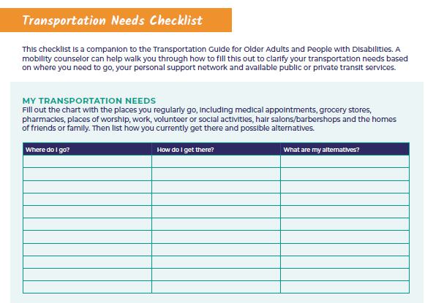
Notes:
The guide features a useful insert, the Transportation Needs Checklist, created to help the user clarify his/her personalized transportation needs. This checklist encourages individuals to review their existing transportation support network and explore what alternatives might be available should the need arise.

Slide 6
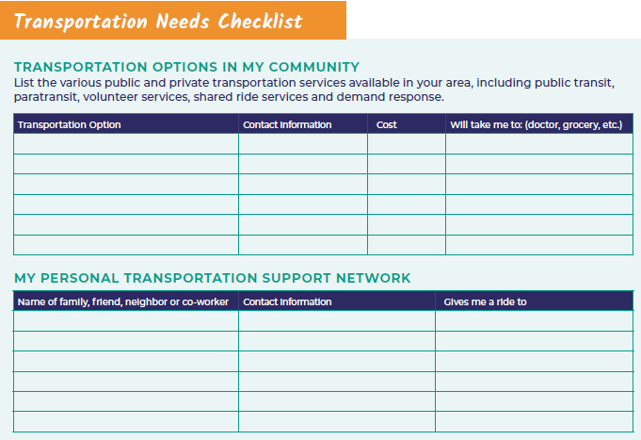
Notes:
Once you determine where you need to go, use this page to list the transportation options in your area, and to list the names and numbers of those in your own support network.

Slide 7
Key Considerations: Planning Your Trip
What is the cost of this service?
Are accessible vehicles available?
How long will I have to wait?
Can my caregiver ride with me?
What is your coverage area?
Notes:
On pages 8-9, the Guide also features a section called “Key Considerations” which helps the rider consider various important questions as they plan a trip. Users are encouraged to think about any special accommodations and ask providers questions to evaluate their choices.

Slide 8
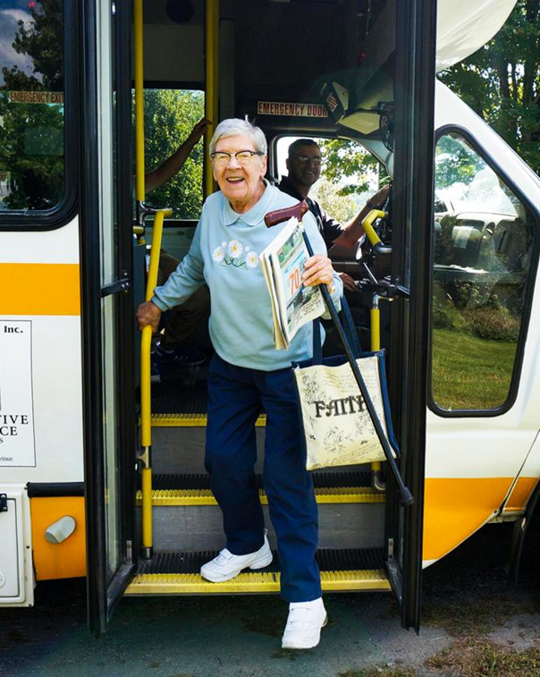
Transportation Toolkit
In addition to the Transportation Guide, be sure to check out the Transportation Toolkit for additional resources, such as:
  Driver Safety Resources
  Accessible Transportation Information
  Transportation Games & Fun
Notes:
Centralina AAA has created an online resource toolkit that that offers something for everyone including service agency staff, older individuals who drive, and those who need transportation services. We’ve included a bit of transportation fun as well!

Slide 9
Ready for some fun?
(Select a Transportation Game from our Transportation Toolkit on our website)

Slide 10
For more information, contact:
Katie Kutcher - kkutcher@centralina.org or 704-348-2705
Laurie Abounader – labounader@centralina.org or 704-688-6501

Slide 11
THANK YOU
704-372-2416 | info@centralina.org | 10735 David Taylor Drive, Suite 250, Charlotte, NC 28262 | www.centralina.org

