Slide 1
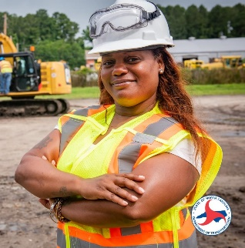
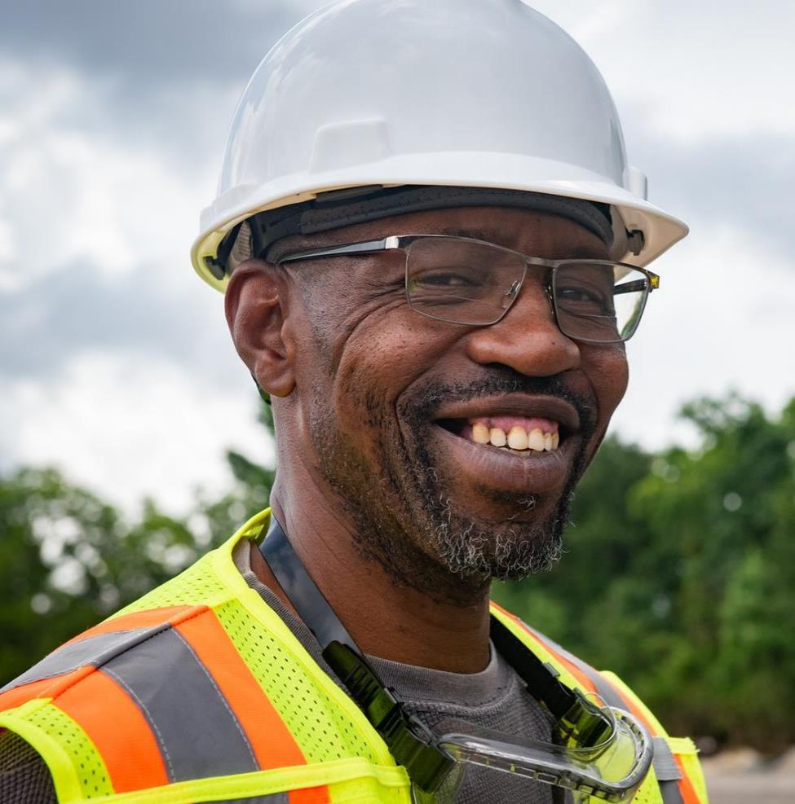
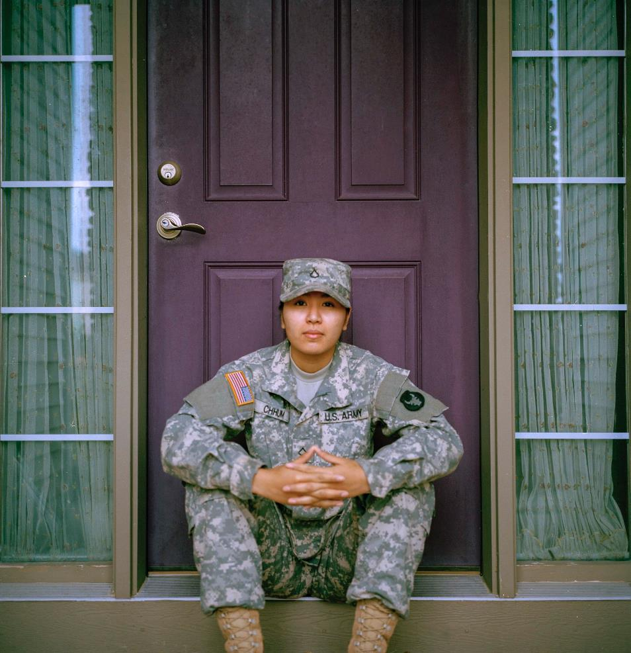
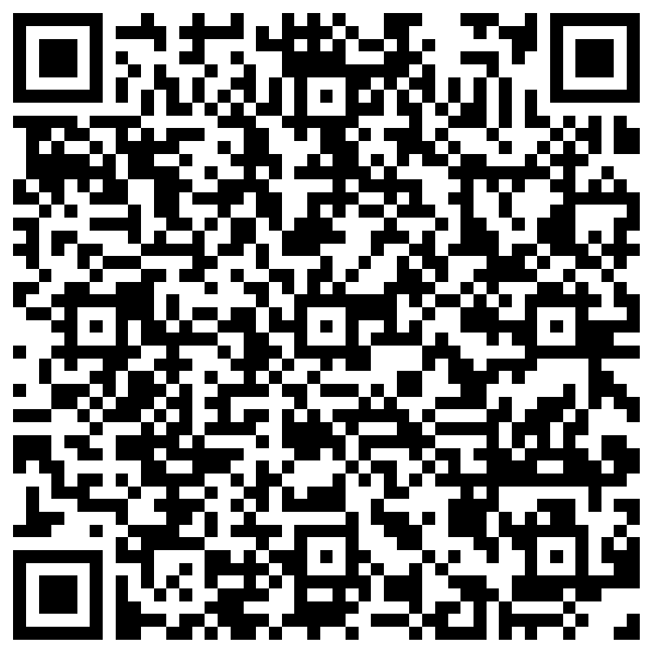
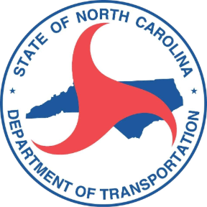
Scan to Register
NCDOT HIRING EVENT
Apply | Get Screened | Interview | Get Hired | Free and open to all! | Hiring teams on site
ONE DAY ONLY!
Wed, Aug 21
8:30a – 2pm
NCWorks Career Center
1830 Tiller Place #B
Raleigh, NC 27604
Now Hiring in Wake County!
You deserve a great place to work
We hired 12 at our last Hiring Event
We have 27 openings at this event
Make your Summer and join us!
Openings | Avg Salary | Education & Experience
Transportation Worker I | $43,000 | High School/GED
Transportation Worker II | $50,000 | High School/GED & 3+ years experience
Transportation Worker III | $55,500 | High School/GED & 5+ years experience
Automotive Mechanic - Heavy Equipment Repair Technician II | $55,000 | High School/GED & 2+ years experience
Engineering Technician I | $55,000 | Associates Degree
Engineering Technician II | $61,000 | Associates Degree & 2+ years experience
Register Now
https://bit.ly/NCDOTWakeHiringEventAug24
NCWorks is an Equal Opportunity Employer/ Program. Auxiliary aids and services available to individuals with disabilities upon request.
The Capital Area Workforce Development Board's Workforce Innovation and Opportunity Act (WIOA) Programs are federally supported 100% by the US Department of Labor as part of an award of $1M+.

